Slide 1
Welcome
Fahad Ahmed Patwary
0112230077
01

Slide 2

Email
Etiquettes
02

Slide 3

What is email etiquette?
Email etiquette is the use of appropriate language, conventions and formality in an email.
Having good email etiquette makes it more likely that people will respond positively to your emails. It shows people that you are professional and polite, and makes it less likely to cause misunderstanding. Student and professionals mostly use email etiquette so they should know about email etiquette.
03

Slide 4

Parts of an Email
Sender and Receiver
To, CC, BCC
Subject Line
Salutation/Greeting
Email Body
Attachments
04

Slide 5


To
Whom you are writing the email. That’s mean the receiver, the main target audience.
CC
Email address of the person, Who is not the main target audience, but who needs to be kept in loop.
BCC
Like CC, But other parties that are involved added in BCC. Best is to avoid using BCC, Breach of privacy.
05

Slide 6

Salutation/Greetings
Salutation should be professional, even when the email is sent for non-professional reasons.
Subject Line
Should be crisp, concise, short, informative enough and related to the email content.
Proper Greetings:
Dear Dr. Jones
Hi Prof. Smith
Dear Ms. Muntaka
06

Slide 7

Email Body
Usually Consist of three parts:
Introduction (Beginning)
Middle (Reason for email)
End (Closing Remarks)
Attachments
The name of the attachment should be professional.
Example: Mumtahim_CV.pdf, Instead of myCV.pdf
Short and concise
Some closing remarks
07

Slide 8
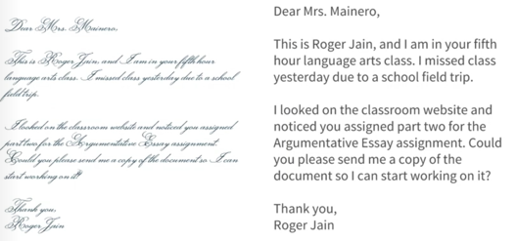
Font
&
Tone
Use professional fonts
Avoid multiple color and font size
Highlight important points
Use bullet points where it is needed
08

Slide 9
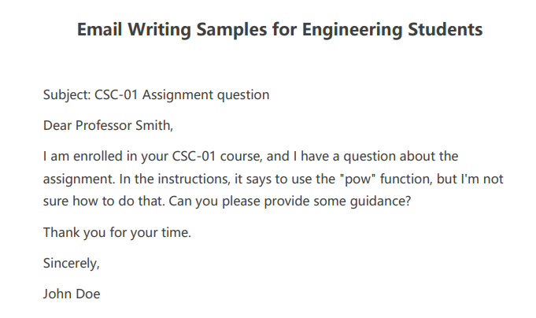
Email
Example
09

Slide 10
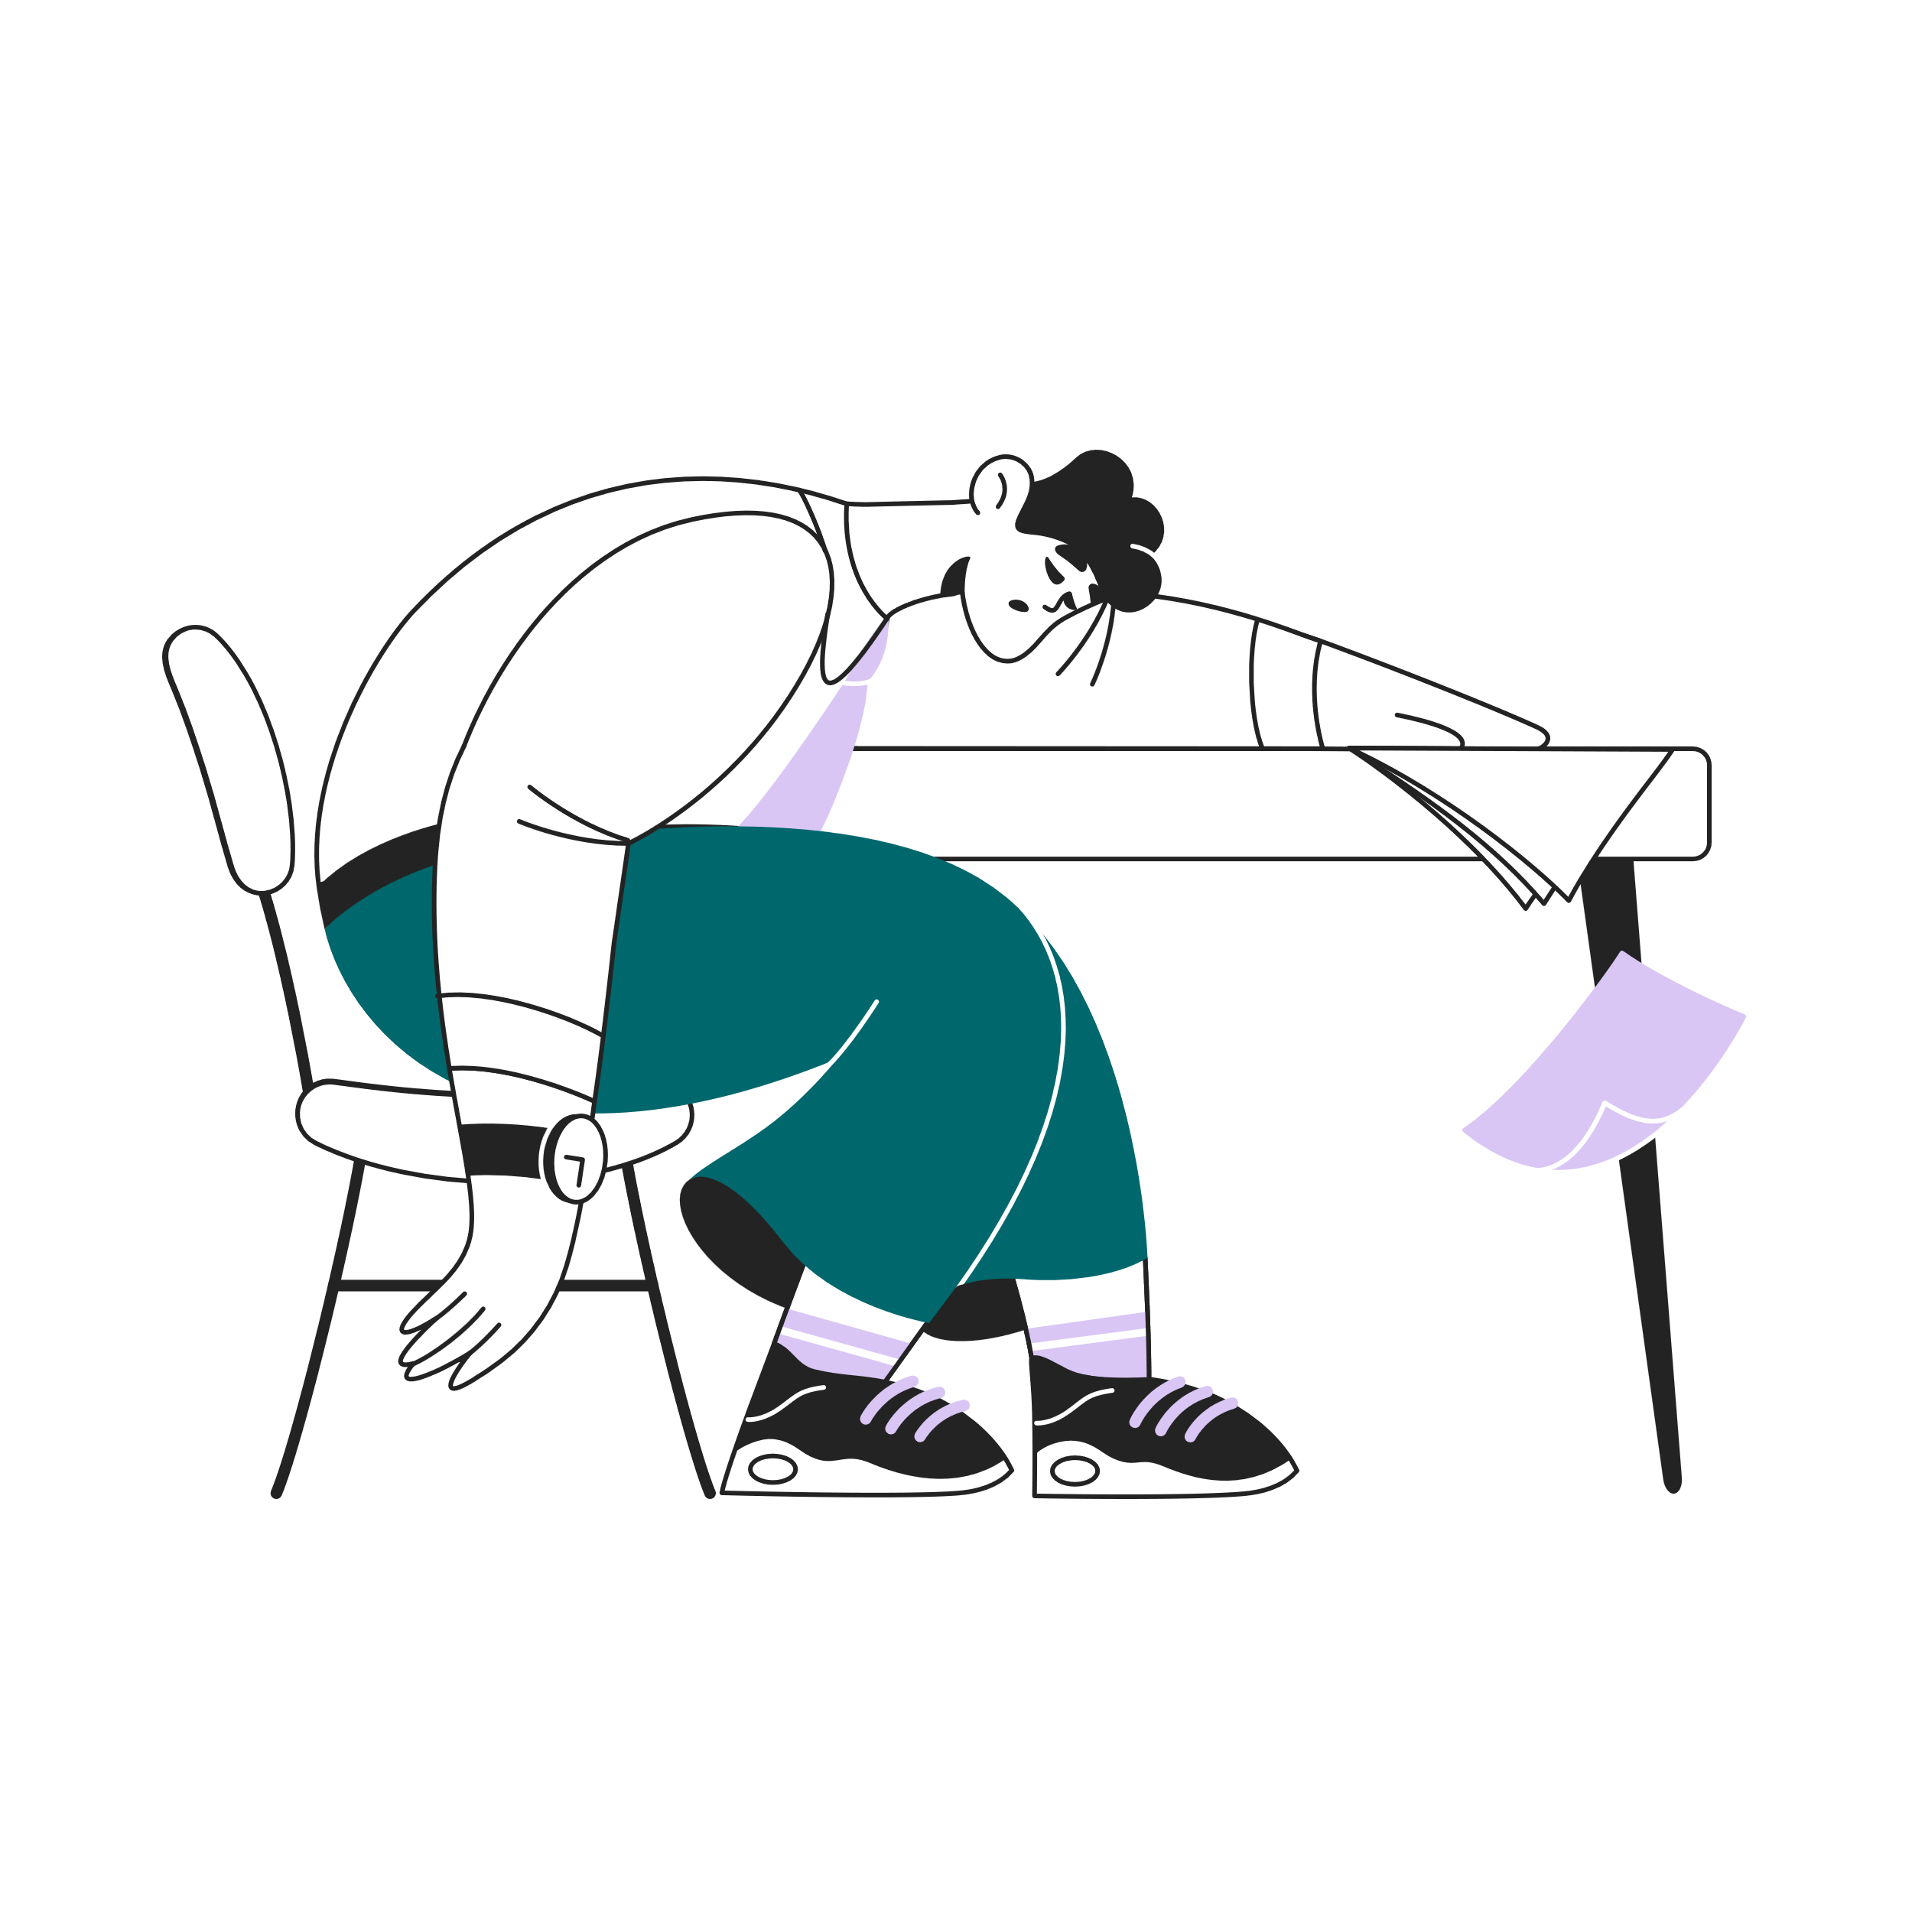
Stress
Management
10

Slide 11
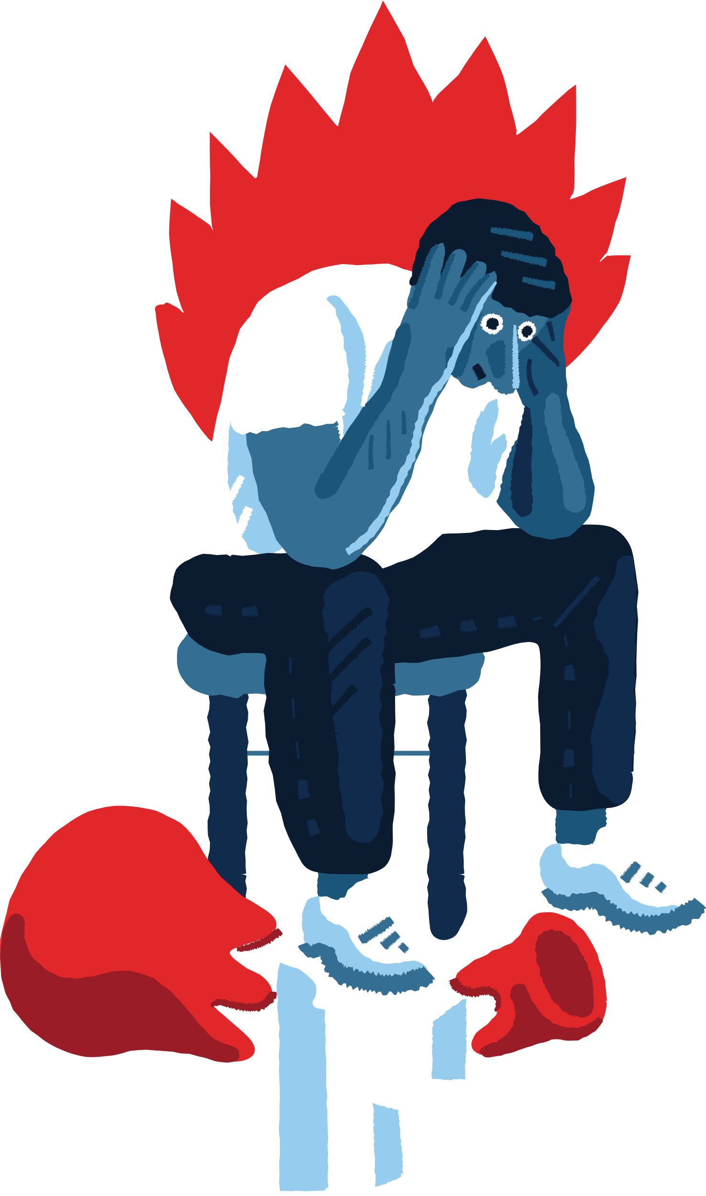
Stress?
Stress can be defined as any type of change that causes physical, emotional or psychological strain. Stress is your body's response to anything that requires attention or action.
Three type of stresses:
Acute stress
Episodic acute stress
Chronic stress
11

Slide 12
Some Good
Stress
What is good stress?
Good stress, or eustress, is the type of stress you feel when you’re excited. Your pulse quickens and your hormones surge, but there is no threat or fear. You might feel this type of stress when you ride a roller coaster, compete in a game, or go on a first date.
Some examples of good stress:
Receiving a promotion or raise at work
Starting a new job
Marriage
Buying a home
Having a child
Getting good marks in exam
12

Slide 13
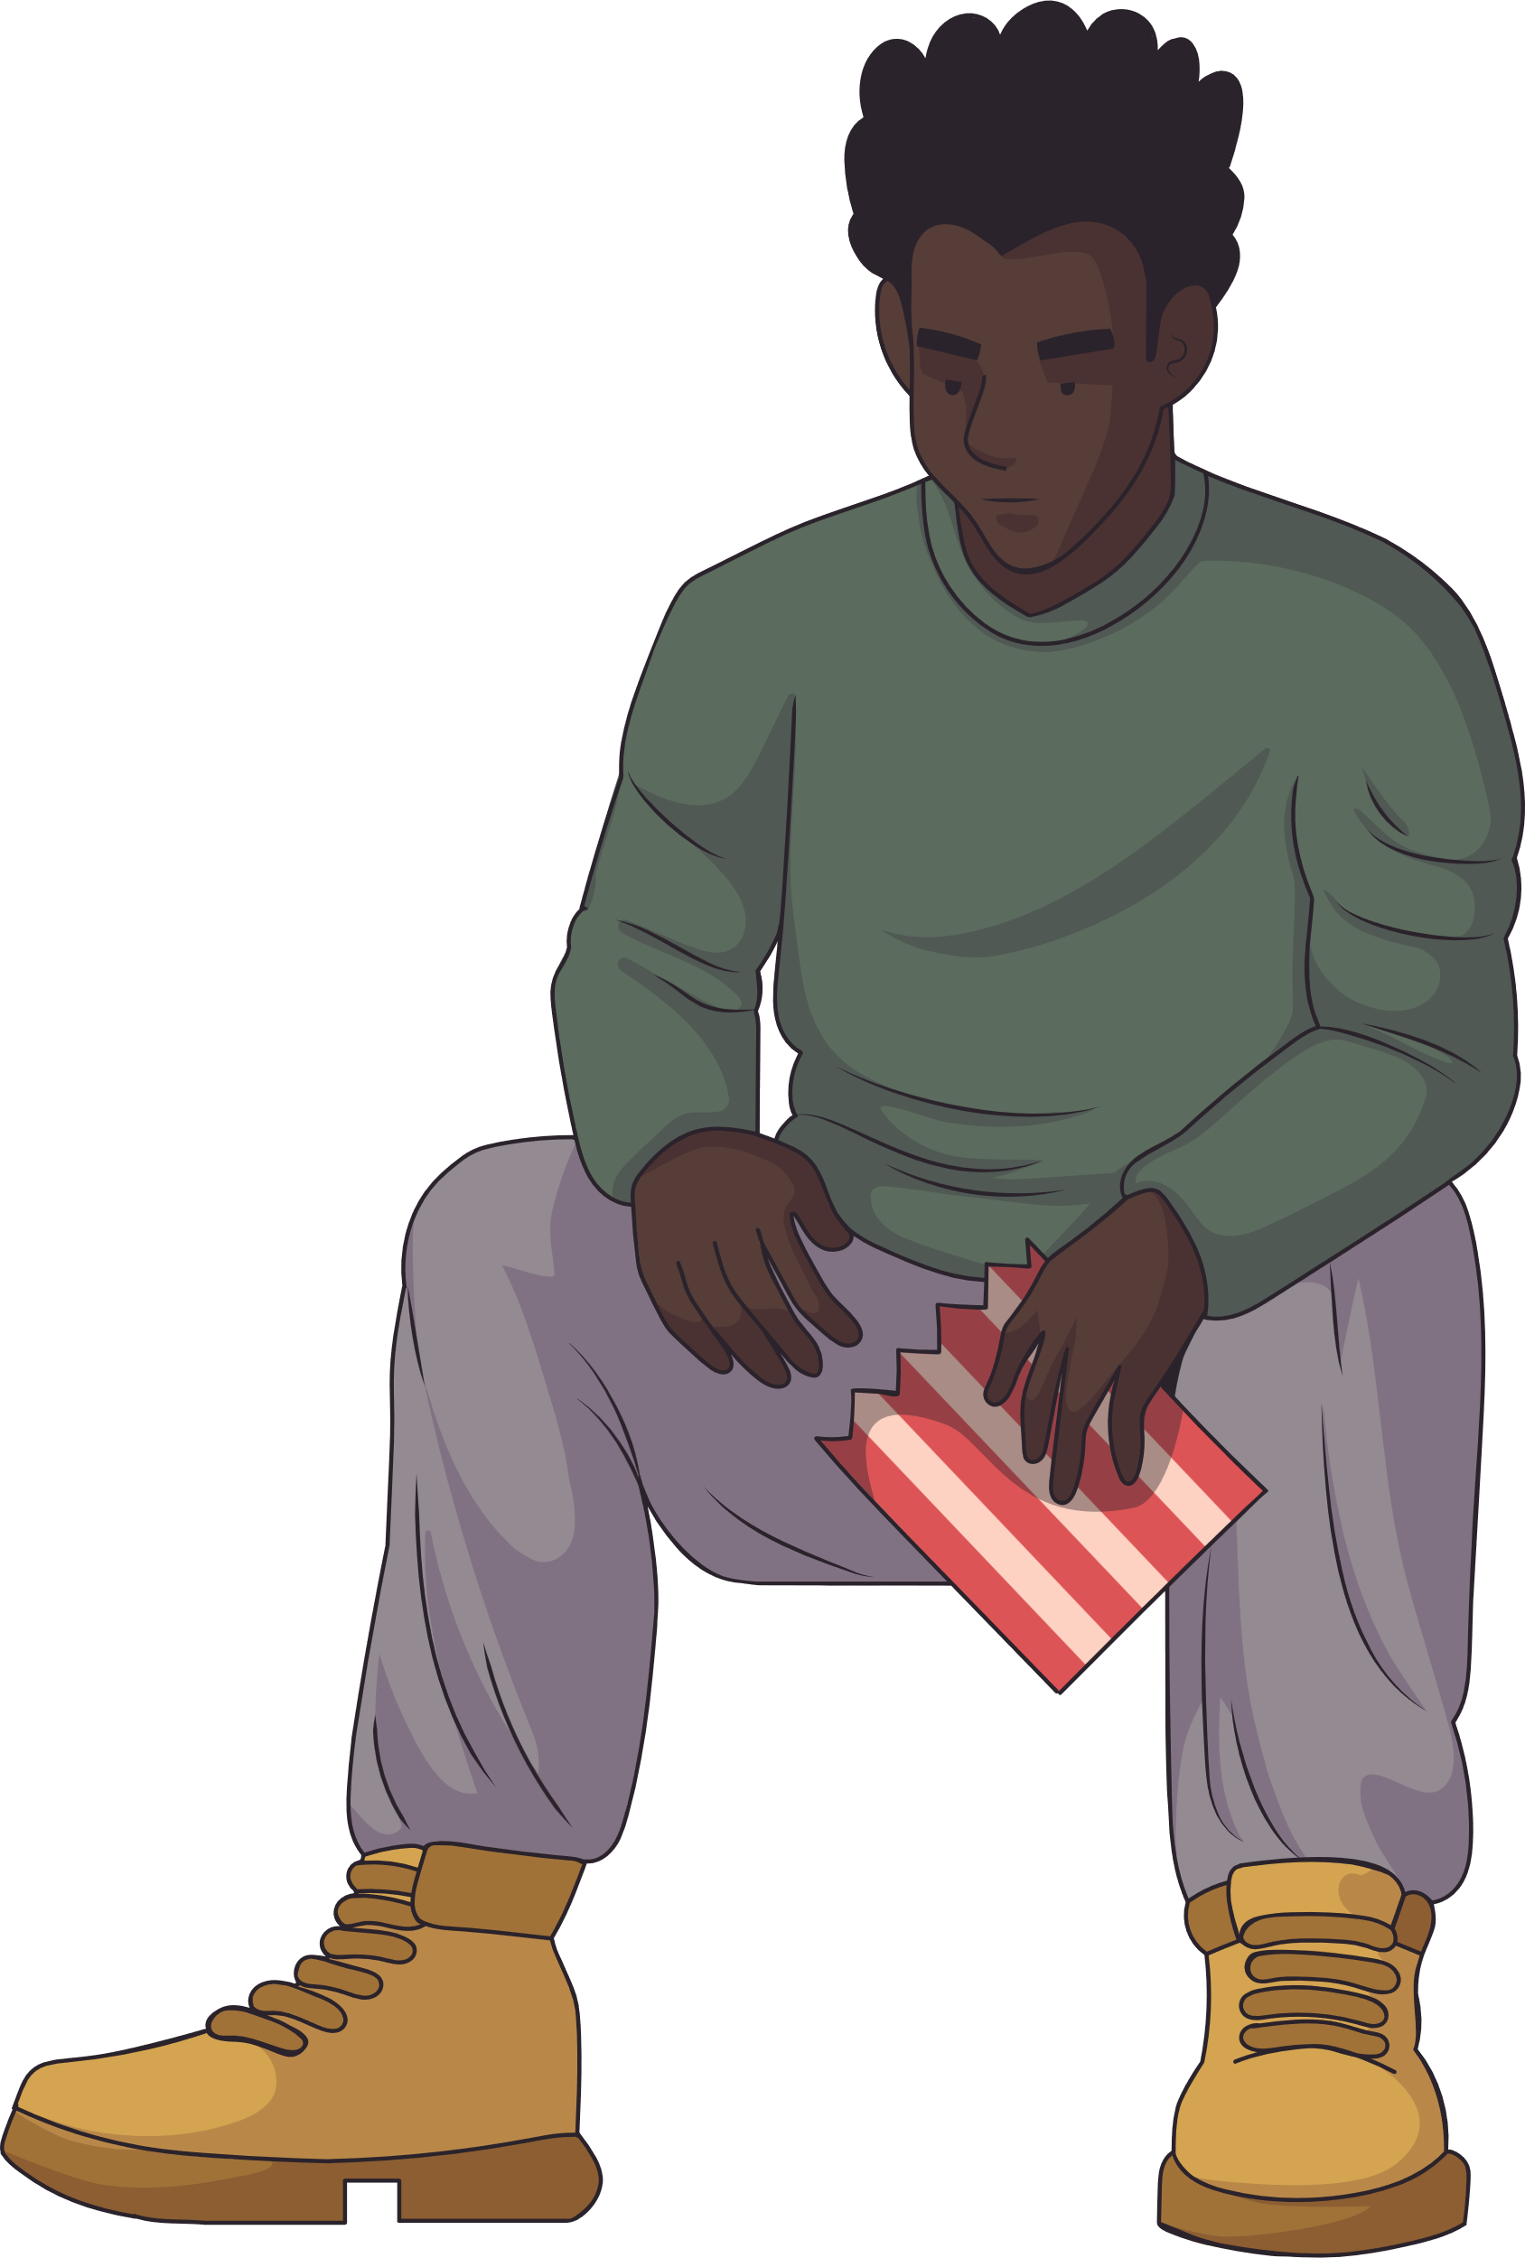
What Makes Something
Stressful?
Imminent Situation
Strong Demands
Life Transitions
Ambiguity
Desirability
Controllability
13

Slide 14

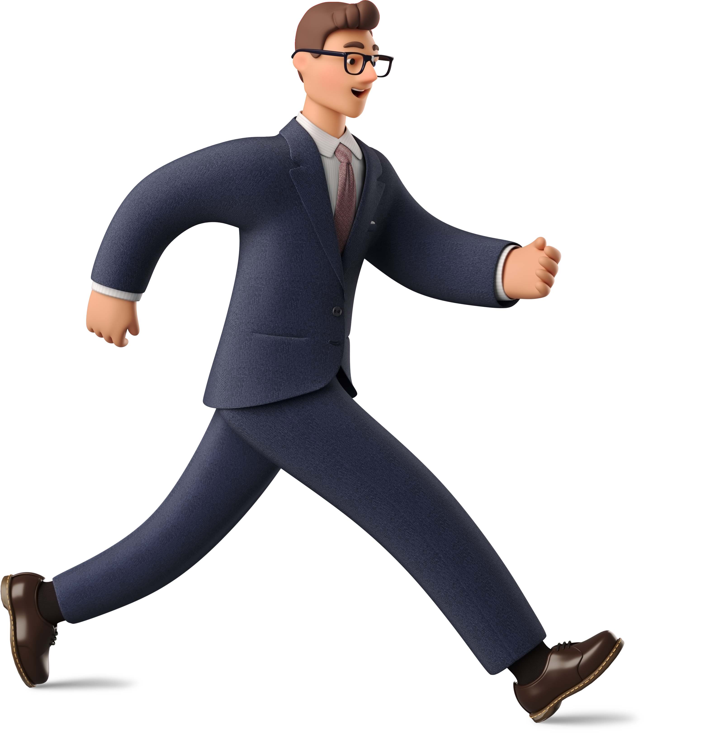
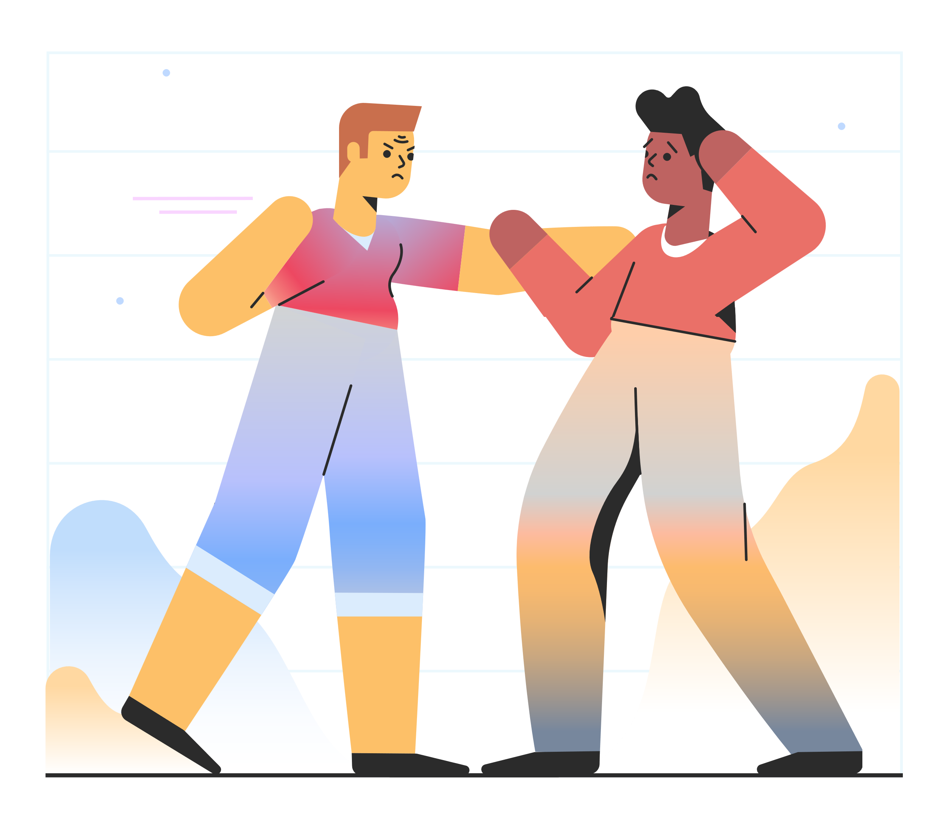
The “Fight or Flight” Response
?
14

Slide 15
Stress
Response
A good example of a stressful situation for many people is taking a test. If you find testing to be stressful, you might notice certain physical, behavioral, mental and emotional responses.
02
03
01
Behavioral Response
Mental Response
Physical Response
15

Slide 16
Reduce Stress
Change Attitude
Be Realistic
Organize and Change
Find other ways to think about stressful situations.
- ”Life is 10% what happens to use, and 90% how we react to it.”
Set practical goals for dealing with situations and solving problems.
- Develop realistic expectations of yourself and others.
Being unorganized or engaging is poor planning often leads to frustration or crisis situations, which most always leads to feeling stressed.
Take Break, Give yourself “me time”
Learn to say “NO”
Regular Exercise
Learn that taking time to yourself for rejuvenation and relaxation is just as important as giving time to other activities.
Learn to pick and choose which things you will say “yes” to and which things you will not.
Exercising regularly can help relieve some symptoms of depression and stress. It help us to maintain out health.
16

Slide 17
Learn to relax
Slow Down
Laugh, Use Humor
Develop a regular relaxation routine.
Try Yoga, meditation, or some simple quiet time.
Know your limits and cur down on the number of things you try to do each day. Particularly if you do not have enough time for them or for yourself.
Do something fun and enjoyable such as seeing funny movie, laughing with friends, reading a humorous book, or going to a comedy show.
17

Slide 18
Now say what is stressful to you?
Work | Roommate | Legal matters
Classes | Childcare | Mental health
Studying | Finances | Law violation
Relationship with partner | Appearance | Spiritual/Religious issues
Relationship with family | Physical Health | Major/Career decisions
Relationship with friends | Not “fitting in” | Attitudes/thoughts
Trauma | Getting married | Buying a house
Change in residence | Change to a new school | Change in amount of recreation
Change in amount of social activities | Change in eating habits | Death of friend/family member
18

Slide 19

Money
Management
19

Slide 20

Money Management?
Money management refers to the process
of:
Budgeting
Saving
Investing
Spending
Why money management is important?
Creates independence, Helps us to avoid
Debt, it help us to set and reach out our
goals, Prepares us for the future.
20

Slide 21

Common Mistakes
Spending every penny instead of saving
Living beyond your means – Racking up the debt
Letting your bills slide – Not paying on time
Spending extra student loan money
Not researching to find the best deals
Not keeping track of account transactions & balances
21

Slide 22
Important!
Need
Money Management
Strategies
40%*
We must know the difference between Want and Need. We must track out expenses and stick to our budget.
Want
20%*
Savings
40%*
22

Slide 23
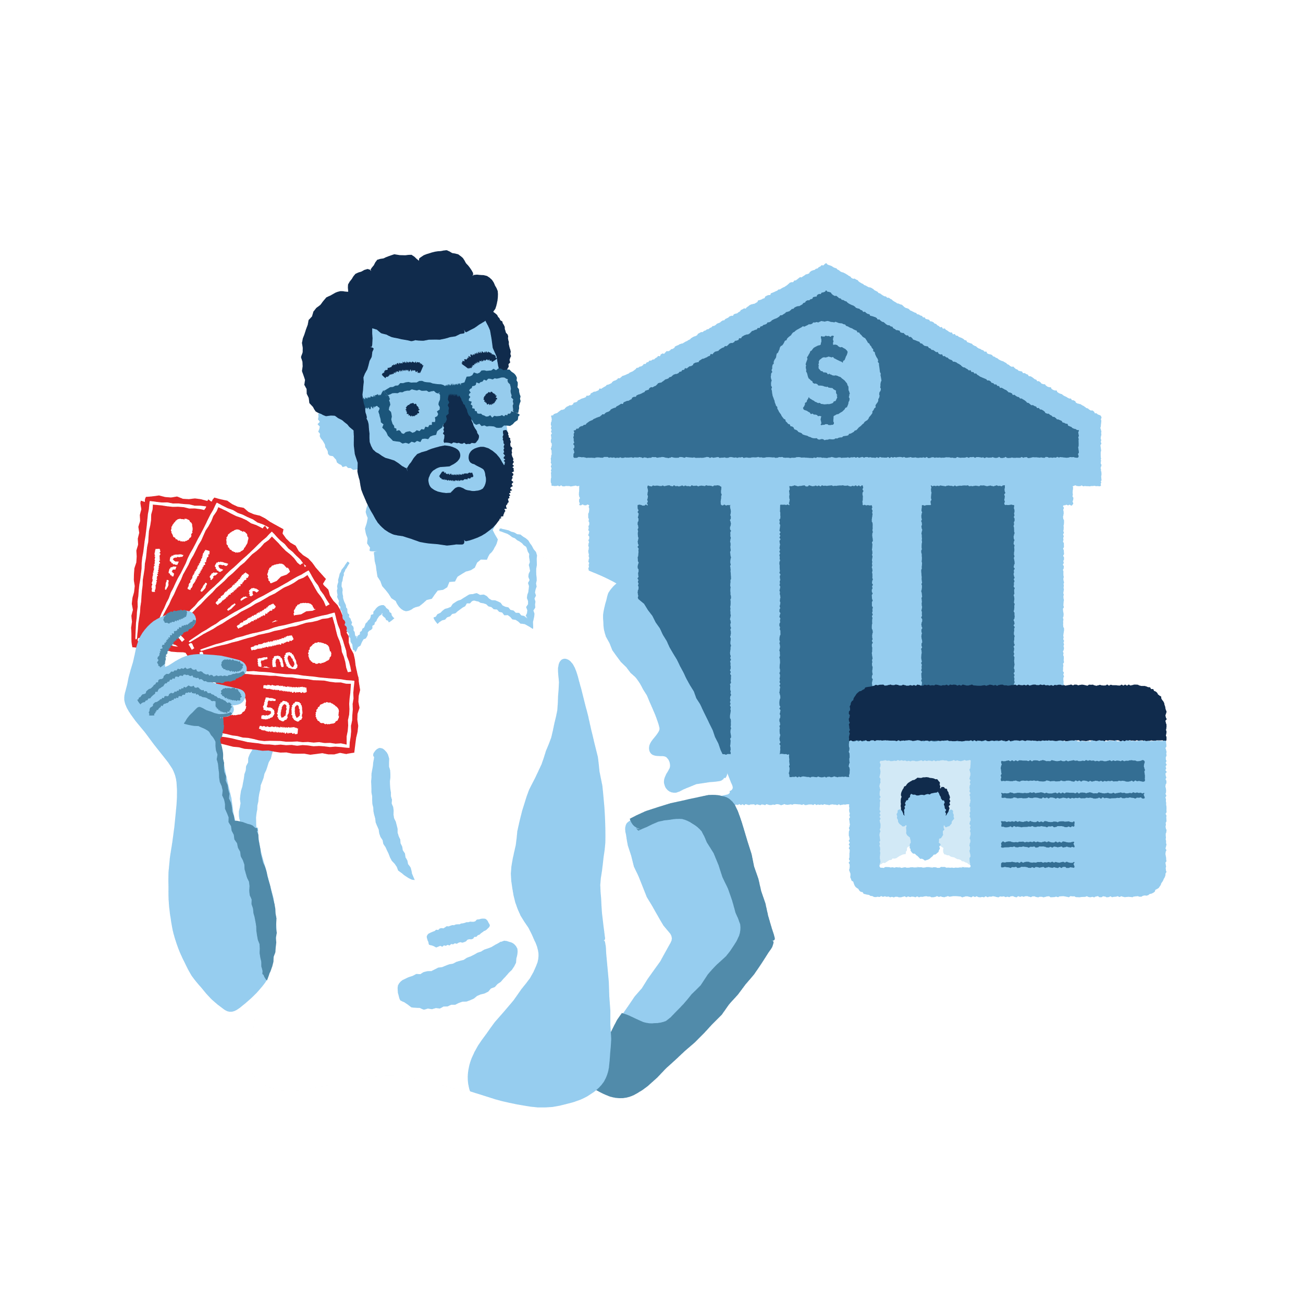
Money Management
Strategies
Take advantage of discounts- Utilize cashback offers
Save a particular amount weekly instead of monthly
Build an emergency fund
Turn a hobby or a skill into money – making endeavor
Pay the rent on time to avoid late fees
Save on snacks
23

Slide 24
Thank You
24

